Slide 1
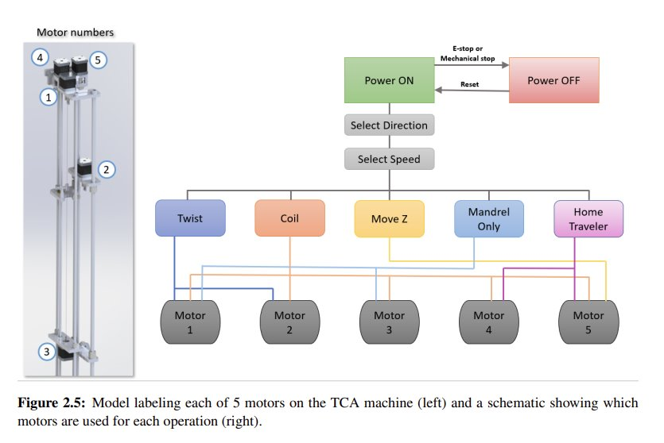
Motor electrical Schematics

Slide 2
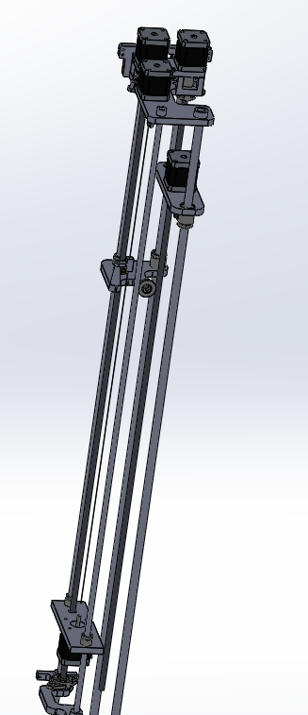
Motor Orientation
Z
Y
X
E0
E1

